Slide 1
Unit 5
Testing and Rolling out Enterprise Applications

Slide 2
Testing Enterprise Applications
Testing
Software testing is the process of evaluating and verifying that a software product or application does what it is supposed to do.
Benefits of Software Testing
1. Preventing bugs
2. Reducing development costs
3. Improving performance

Slide 3
Testing Enterprise Applications (contd..)
Categories of Software Testing
Based on “what” needs to be tested, testing is divided into
Functional Testing – Testing the functional requirements stated by the user
Nonfunctional Testing – Testing the nonfunctional requirements like security,
performance, maintainability, reliability, availability, scalability
Based on “how” to test, testing is divided into
White-box Testing – tests the internal structure of the application in detail
Black-box Testing – focuses on testing the application from external perspective
Gray-box Testing – It is a hybrid of white-box and black-box testing. In this type of
testing, test planning is done keeping internal code in mind but finally
testing happens like black-box testing

Slide 4
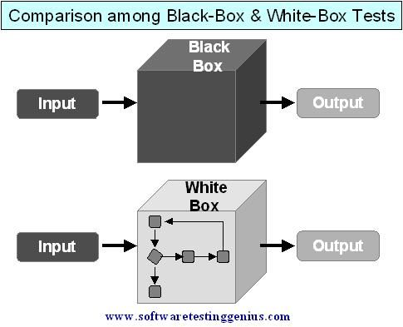
Testing Enterprise Applications (contd..)
Black-box testing vs White-box testing

Slide 5
Testing Enterprise Applications (contd..)
Black-box testing vs White-box testing
Black-box testing | White-box testing
It is a way of software testing in which the internal structure or the program or the code is hidden and nothing is known about it. | It is a way of testing the software in which the tester has knowledge about the internal structure or the code or the program of the software.
Implementation of code is not needed for black box testing. | Code implementation is necessary for white box testing.
It is mostly done by software testers. | It is mostly done by software developers.
No knowledge of implementation is needed. | Knowledge of implementation is required.
It can be referred to as outer or external software testing. | It is the inner or the internal software testing.
It is a functional test of the software. | It is a structural test of the software.
It is least time consuming. | It is most time consuming.

Slide 6
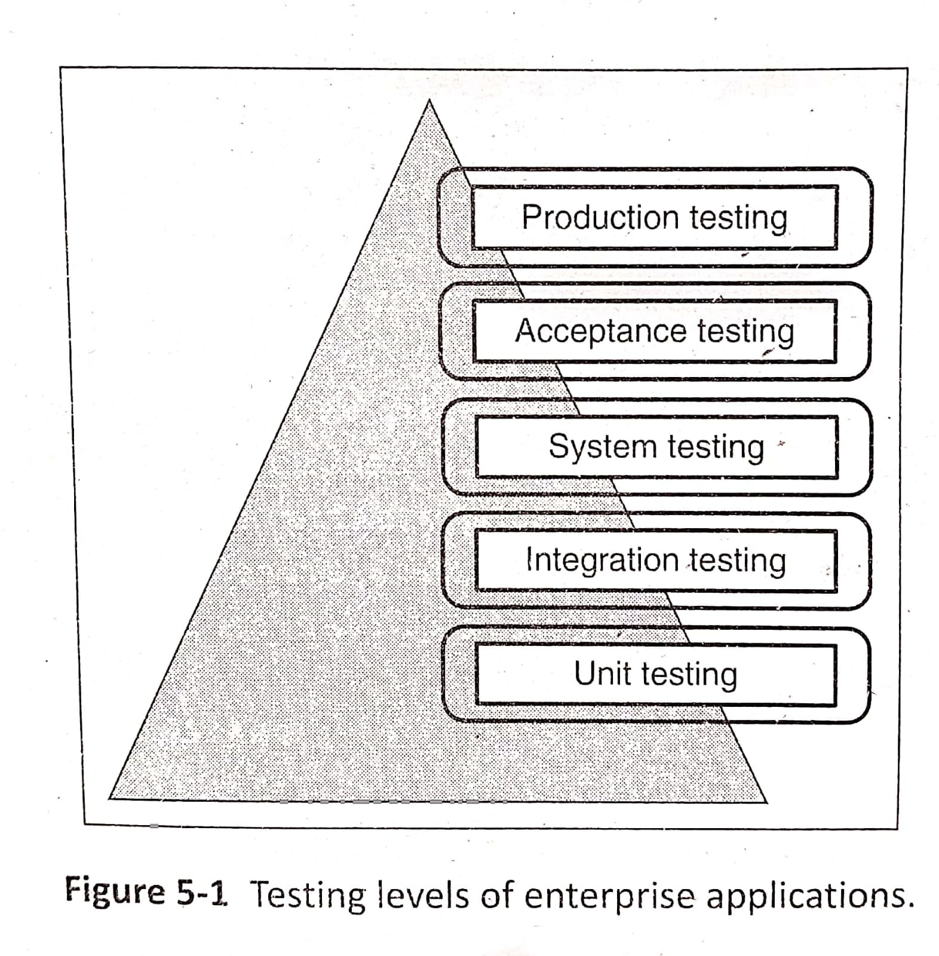
Testing Enterprise Applications (contd..)
Testing Levels
Testing has to be done at various levels before rolling out enterprise applications
Below diagram shows the different levels of testing the applications

Slide 7
Testing Enterprise Applications (contd..)
Testing Levels
1. Unit Testing: This testing is done to ensure that a function/module/class works correctly. First
phase of testing which happens in construction phase
2. Integration Testing: This testing is done to ensure that function/module/classes are grouped
together without any problems. Combination of classes or modules works
correctly
3. System Testing: This testing involves testing the entire system as a whole. Third level of testing
4. Acceptance Testing: This testing is done by the end users. Fourth level of testing
5. Production Testing: Last level of testing. It is basically a release of the enterprise application in the production environment. It is done basically for the firsthand feel of the live
enterprise application

Slide 8
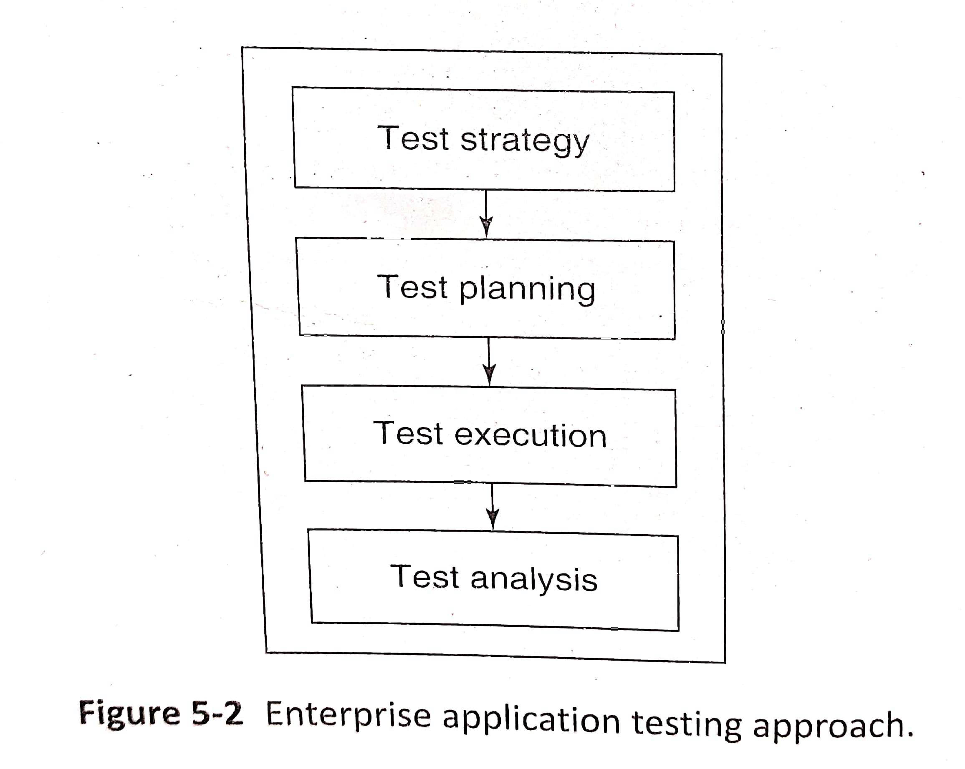
Testing Enterprise Applications (contd…)
Testing approach
Below figure represents the approach used for enterprise application testing

Slide 9
Testing Enterprise Applications (contd…)
Testing approach
1. Test Strategy
Refers to the overall approach for testing the application
It considers environment, types of testing to done, testing team, cost and timeline of testing, tools to be used, test planning and when to end testing
Test strategy also includes entry (when to start testing) and exit criteria (when to end testing) for various types of testing
Output of this phase is the test strategy document
2. Test Planning
Test planning is used to plan the execution of tests
It contains information about tests to be performed along with test cases and test procedures
Test cases specify specific features and scenarios for testing, steps to carry out testing and test data with expected results
Test procedures explains the steps involved in executing the test

Slide 10
Testing Enterprise Applications (contd…)
Testing approach
3. Test Execution
Next step is to execute the test once test plan is ready
Unit testing and integration testing is done by development team
Separate teams are formed to execute system testing
Each of the test cases is executed and results are logged
Defects are entered into defect tracking system and passed on to development team
4. Test analysis
Defects captured are analysed for complexity, type, severity, impact etc
Corrective actions are taken based on defect analysis

Slide 11
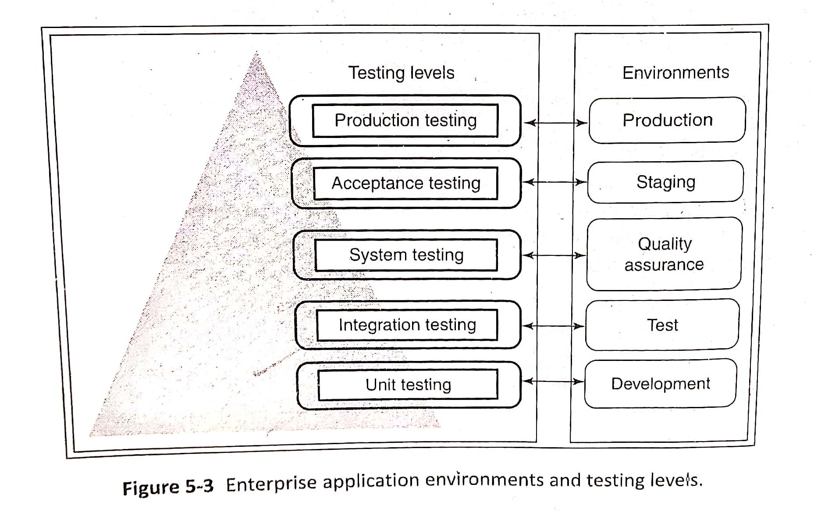
Enterprise Applications Environment
There are several types of environment that an enterprise application passes through its lifecycle
Below diagram shows different environments where different levels are testing are being carried out

Slide 12
Integration Testing
Software units/components are integrated(combined) after unit testing
The interfaces among these units/components are tested to ensure the working of these units when combined together
Integration testing is an example of Gray-box testing
Regression Testing
In iterative methodologies, same component will be changed several times. It is important to
ensure that a change in component does not affect another part of the application. To ensure this
after each iteration, application is regression-tested. Regression testing includes running the
previous test cases and comparing the results with previous test results. HP Quick Test and IBM Rational Functional Tester are some of the Regression Testing tools

Slide 13
Integration Testing (contd..)
Sample Integration test cases
Some of the integration test cases used for Loan Management system are,
Entre the details of loan application in the loan initiation form and submit the same
Store loan application attributes in the loandetails table

Slide 14
System Testing
System Testing is testing the enterprise application and its interfaces as a whole
It is a Black-box testing
System testing tests both functional and non-functional requirements
Under System Testing following are the testing that are carried out
1. Performance Testing
2. Penetration Testing
3. Usability Testing
4. Globalization Testing
5. Interface Testing

Slide 15
System Testing (contd…)
1. Performance Testing
One of the important system testing
Performance testing is used to test the responsiveness of the system under a given workload, scalability to handle the growth in number of users, data volume
Apache JMeter and Loadrunner are examples of tools used to test the performance of enterprise applications
Following are the testing carried out to verify the application performance
a. Load Testing: Application is subjected to a variety of loads in terms of number of users accessing it.
b. Volume Testing: Volume Testing is carried out by varying the volume of data processed by the system. This testing is done on all key, frequently-used
functionalities
c. Stress Testing: Stress testing is done where the application is put to extreme stress in form of large volume of users and data. It is done to ensure that the application can handle spikes in load due to unusual circumstances
d. Endurance Testing: Endurance testing is done to identify problems related to memory leaks

Slide 16
System Testing (contd…)
Performance Testing
Objectives of the Performance Testing
Determine enterprise application performance at a given user load and data volume
Determine the breaking point of the system under load and stress testing
Benchmarking the performance
To determine the reasons for performance bottlenecks

Slide 17
System Testing (contd…)
Performance Testing
Performance Test cases
Login to the LoMS application
Initiate loan application form
Loan application submission
Logout from LoMS application

Slide 18
System Testing (contd…)
2. Penetration Testing
Penetration Testing is the black-box testing from the security perspective
This testing helps in protecting application against various online threats
It also ensures whether application is in compliance with industry regulations
Penetration Testing is a part of the overall application security Engineering life cycle
Fortify 360, Paros Proxy, OWASP WebScarab are popular tools for doing Penetration testing

Slide 19
System Testing (contd…)
3. Usability Testing
This testing is a black box testing to ensure whether the application is easy to understand and use
This type of testing is usually done by end users or by business analysts
Usability test cases:
Some of the integration test cases used for Loan Management system are,
Loan initiation
Loan approval
Help
Personalization
Globalization

Slide 20
System Testing (contd…)
4. Globalization Testing
Enterprise application are used by people all over the world. This requires an application to be localized for the user needs to ensure customer friendliness
This testing is done to validate whether an enterprise application meets the internationalization requirements
Language translation, currency symbols, date and time format, time zones, number formatting, fonts, sizes are the main things that are validated under this testing

Slide 21
System Testing (contd…)
5. Interface Testing
Interface testing validates the incoming and outgoing interfaces of the application with respect to all other applications it interacts with
This testing is also called intersystem testing
Interface testing depends on nature of communication of interfaces, request-response handling of the system, data formats exchanged

Slide 22
User Acceptance Testing
User Acceptance Testing is the Black-box Testing
It is performed by end users who is going to use the system
It is the last stage of testing before rolling out the application
This testing is mostly manual and is carried out in the staging environment
Objectives of User Acceptance Testing
To validate the stated functionalities in the system requirement specification document
To validate nonfunctional requirements like usability and response time
To validate the complete business process
To validate the business data from the outgoing and incoming interfaces

Slide 23
Rolling out Enterprise Applications
Rolling out Enterprise applications means making the application live on the production environment for the end user
During this time only enterprise applications are handed over to the maintenance team
Strategies for rolling out enterprise application
1. Brand new rollout – first rollout of a new application
2. Parallel switch – rollout application in both old and new configuration
3. Rolling rollout – A rolling rollout strategy is used where a new version of a system or application is gradually released to different subsets of users or environments.
4. Phased rollout - A phased rollout strategy is a used to introducing changes or updates to a product or system in distinct phases or stages

Slide 24
Rolling out Enterprise Applications (contd..)
Strategies for rolling out enterprise application
5. Up-down-up rollout
The "Up-Down-Up" rollout strategy involves three distinct phases: an initial "Up" phase, a "Down" phase, and a final "Up" phase. In the first "Up" phase, the new version of the software or system is deployed to a subset of users or environments. Feedback from users are collected. The "Down" phase involves assessing the feedback and data gathered during the initial rollout. Once the issues from the "Down" phase are addressed and the necessary improvements are made, the final "Up" phase involves re-deploying the updated version. This rollout may extend to a larger user base or additional environments.

Slide 25
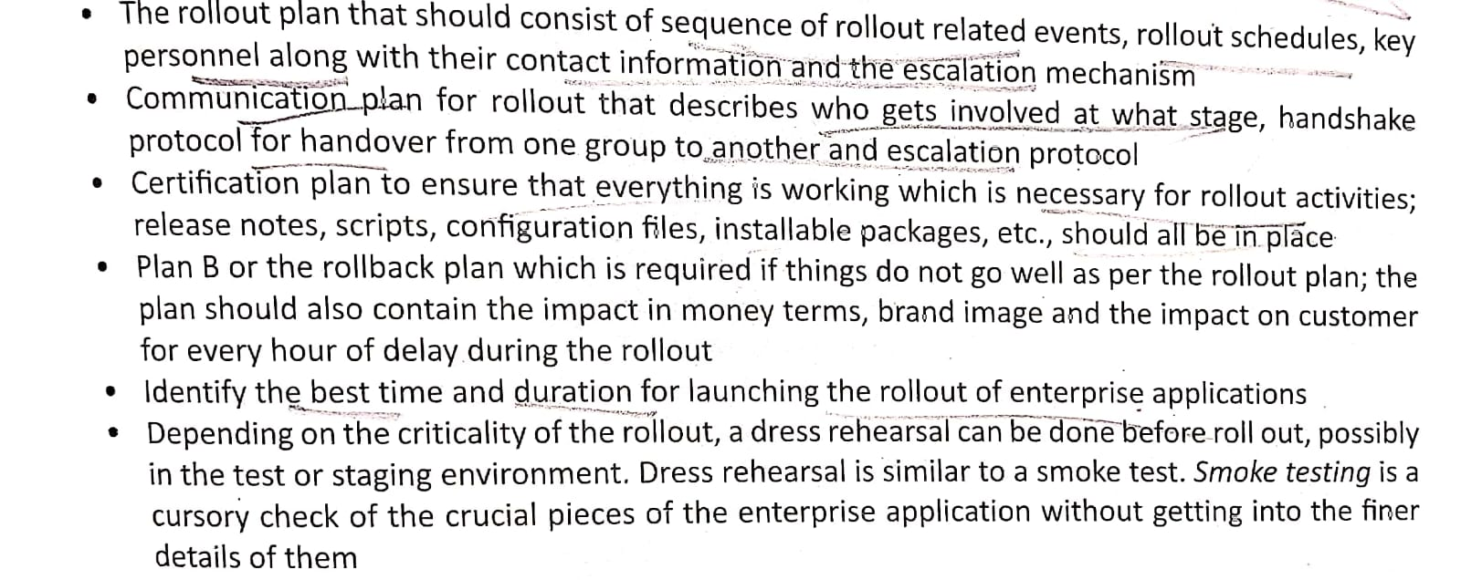
Rolling out Enterprise Applications (contd..)
Key prerequisites for a successful application rollout

Slide 26
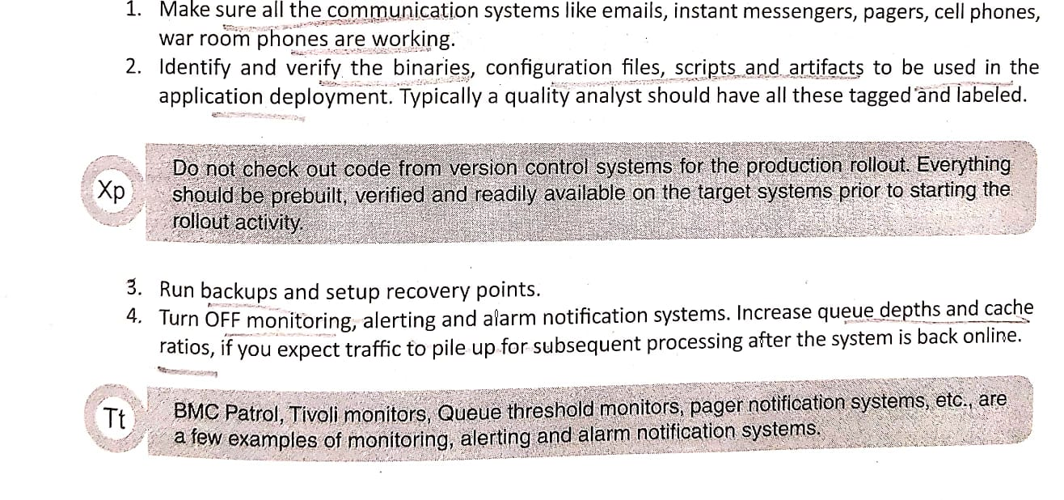
Rolling out Enterprise Applications (contd..)
Steps in application rollout

Slide 27
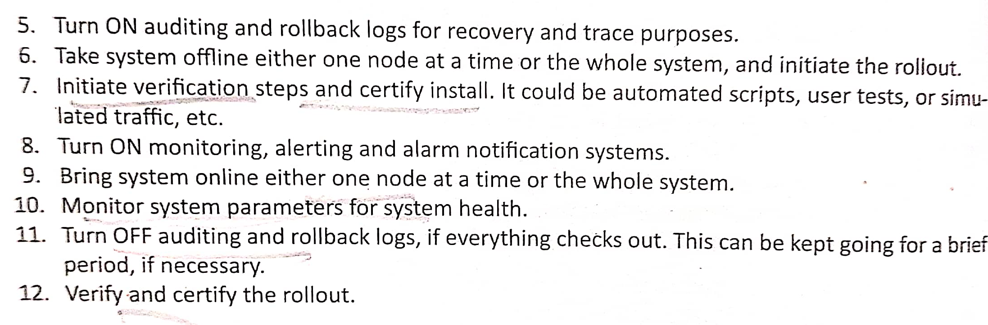
Rolling out Enterprise Applications (contd..)
Steps in application rollout

